Slide 1

Making Byzantine fault tolerant systems tolerate faults
Clement A, Wong E, Alvisi L, Dahlin M, University of Texas, Austin
Marchetti M, University of Modena and Reggio Emilia
Anusha Bangi ● Shubham Pandey
Notes:
PBFT, Q/U, HQ, Zyzzyva the throughtput in worst case scenario is bad, the protocols basically crash at times when faults are inflicted on them. By the end of our presentation I will elaborate on how these protocols fail and how authors of this paper achieve better stability than others.
Gracious Intervals good performance, uncivil Executions when there are faults. We will elaborate on this
We will discuss the use of digital signatures, Regular View Changes and Point to Point Communication

Slide 2
topics
SYSTEM MODEL
ARDVARK
(RBFT)
EVALUATION
PROTOCOL
Anusha Bangi ● Shubham Pandey

Slide 3
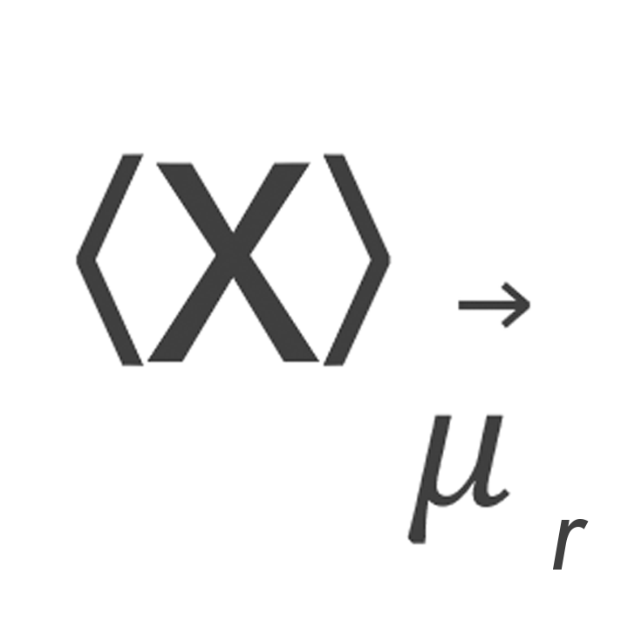
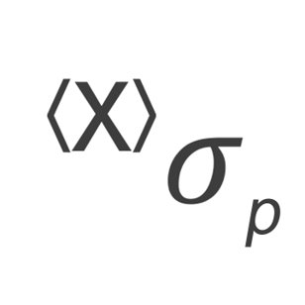
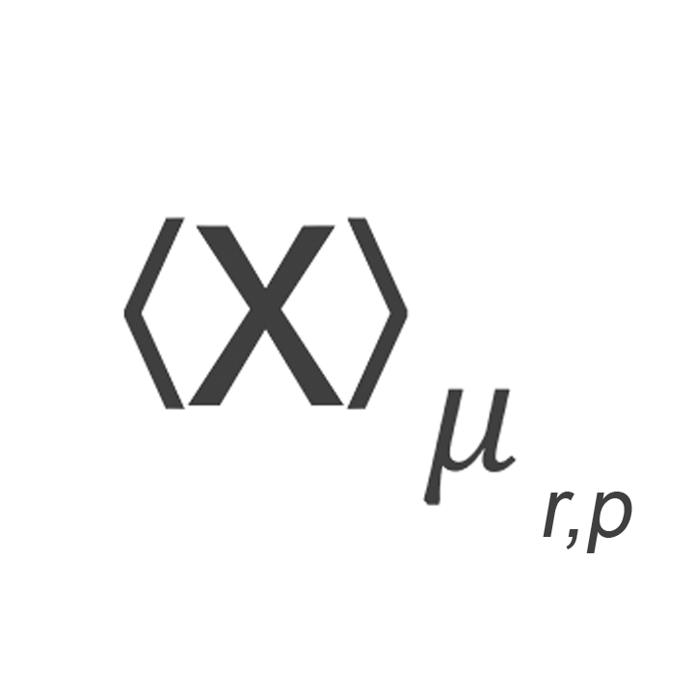
System Model
A Message ‘X’ signed by
principal p’s public key
A Message X with a MAC appropriate for principals ‘p’ and ‘r’​
A Message Containing
MAC Authenticator
Anusha Bangi ● Shubham Pandey
Notes:
This is not the right place for this slide, This should be just before the slide explaining about the algorithm The authors have assumed that any adversaries cannot break the crypto techniques like collision resistant hashing, MACs, encryption and signatures. Talk a little bit about Synchronous Intervals. Don’t dive deep, or he will burn you with questions.

Slide 4
HOW IS ARDVARK DIFFERENT?
Signed Client Requests
Resource Isolation
Regular View Changes

Slide 5
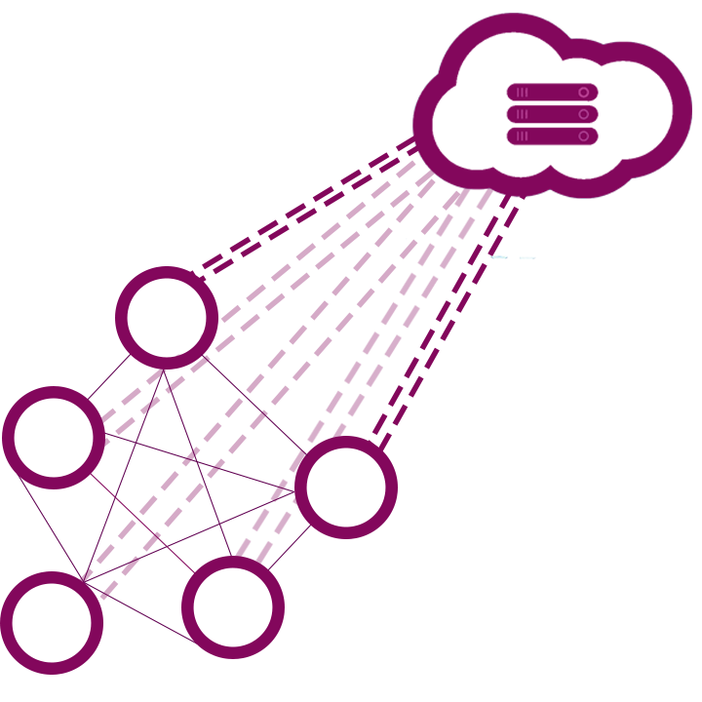
Aardvark
Client Request Transmission
Replica Agreement
Primary View Change
Anusha Bangi ● Shubham Pandey

Slide 6
CLIENT SENDS REQUEST
Anusha Bangi ● Shubham Pandey

Slide 7
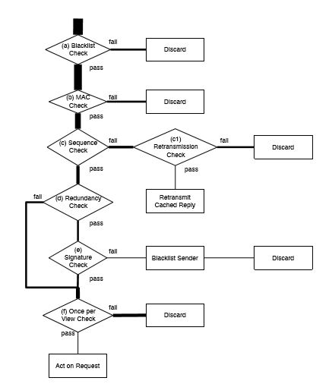

BLACKLIST CHECK
MAC
CHECK
Anusha Bangi ● Shubham Pandey

Slide 8
SEQUENCE CHECK
RETRANSMISSION CHECK
RETRANSMIT CACHED REPLY
Anusha Bangi ● Shubham Pandey

Slide 9
REDUNDANCY
CHECK
SIGNATURE
CHECK
BLACKLIST
SENDER
Anusha Bangi ● Shubham Pandey

Slide 10
ONCE PER VIEW CHECK
Anusha Bangi ● Shubham Pandey

Slide 11
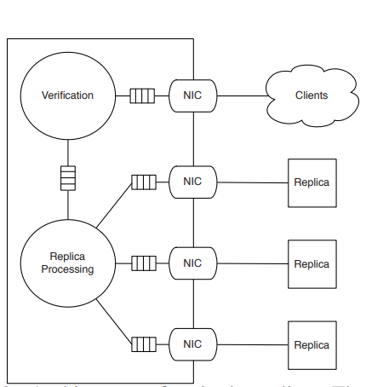
RESOURCE SCHEDULING
Separate work queues for client requests and replica to replica communication
Isolating resources and Parallelism.
Anusha Bangi ● Shubham Pandey

Slide 12
Replica agreement
Aardvark replicas coordinate using the three phase commit protocol
Correct replicas schedule messages in round-robin fashion.
Anusha Bangi ● Shubham Pandey

Slide 13
REPLICA HANDLING MESSAGES FROM OTHER REPLICAS
AGREEMENT PROTOCOL
Notes:
The agreement protocol requires replica-to-replica communication. A replica r ﬁlters ,classiﬁes ,and ﬁnally acts on the messages it receives from another replica according to the decision tree

Slide 14
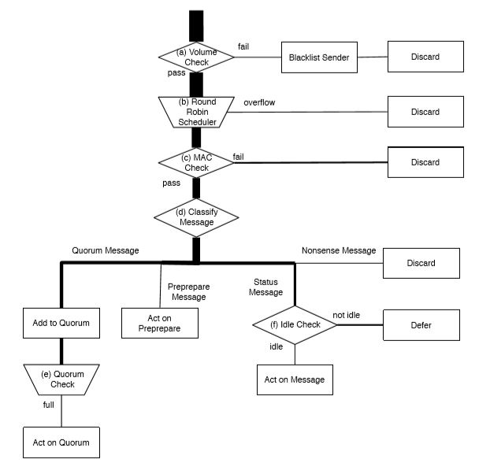
PASS
VOLUME
CHECK
FAIL
BLACKLIST SENDER
PASS
Anusha Bangi ● Shubham Pandey
Notes:
If replica q is sending too many messages, blacklist q and discard the message. Otherwise continue to step (b). Aardvark replicas use a distinct NIC for communicating with each replica. Using per-replica NICs allows an Aardvark replica to silence replicas that ﬂood the network and impose excessive interrupt processing load.
After disconnecting q for ﬂooding, r reconnects q after 10 minutes, or when f other replicas are disconnected for ﬂooding.

Slide 15
ROUND ROBIN SCHEDULER
FAIL
PASS
MAC
CHECK
FAIL
Anusha Bangi ● Shubham Pandey
Notes:
Among the pending messages, select the the next message to process from the available messages in round-robin order based on the sending replica . Discard received messages when the buffers are full.
If the selected message has a valid MAC, then proceed to step (d) otherwise, discard the message.

Slide 16
CLASSIFY MESSAGE
ADD TO QUORUM
ACT ON PREPARE
IDLE CHECK
QUORUM
CHECK
ACT ON MESSAGE
Anusha Bangi ● Shubham Pandey
Notes:
Classify the authenticated message according to its type:
• If the message is PRE-PREPARE, then process it immediately in protocol step 3 below.
• If the message is PREPARE or COMMIT, then add it to the appropriate quorum and proceed to step (e).
• If the message is a catchup message, then proceed to step (f).
• If the message is anything else, then discard the message.

Slide 17
Everything after the before
Primary sends PREPREPARE to all the Replicas.
Replica receives PRE-PREPARE from the primary, authenticates the PRE-PREPARE, and sends a PREPARE to all other replicas.
Replica receives 2f PREPARE messages that are consistent with the PREPREPARE message for sequence number n and sends a COMMIT message to all other replicas.
Replica receives 2f +1COMMIT messages, commits and executes the request, and sends a REPLY message to the client.
The client receives f +1matching REPLY messages and accepts the request as complete.
Anusha Bangi ● Shubham Pandey
Notes:
Upon receipt of PRE-PREPARE from primary p, replica r veriﬁes the message’s authenticity following a process similar to the one described in Section 5.1 for verifying requests. If r has already accepted the PRE-PREPARE message, r discards the message preemptivelyUpon receipt of preprepare replica sends PREPARE:
There are three cases now:
The message was already accepted before for same view: Discard the message
Already accepted in different view: Discard Message
If neither of above: Checks for MAC if wrong: Wrong discard the message. Else if Digital Signature wrong: Blacklist the Primary and Request a view change
If everything was right, log the pre-prepare and send a prepare to all replicas
AFTER LAST POINT IN SLIDE
Catch up Message: If in case some replica lags in processing the request out of any reasons, it sends a status message. If replica r receives a catchup message from a replica q that has fallen behind, then r sends q the state that q to catch up and resume normal operations. Sending catchup messages is vital to allow temporarily slow replicas to avoid becoming permanently non-responsive, but it also offers faulty replicas the chance to impose signiﬁcant load on their non-faulty counterparts.

Slide 18
Primary view changes
Same view change mechanism like PBFT.
Employing view changes to replace the fault primary instead of targeting each of the threats caused.
Anusha Bangi ● Shubham Pandey
Notes:
System throughput Is throughout of primary
A faulty primary can cause: Delay Processing, Discard requests, Corrupt client MAC authentication, Introduce gap in sequence.
Basically, there are 2 things expected from Primary: PrePrepare messages and High Throughput

Slide 19
ADAPTIVE THROUGHPUT
Replica initiates a view change if no pre-prepare messages are received by it before the heart-beat timer expires.
Aardvark uses a heartbeat timer of 40 ms.
If throughput is less than a specified threshold, the replica initiates a view change.
On change of the workload, the required throughput adjusts over n views.
Anusha Bangi ● Shubham Pandey
Notes:
Heartbeat timer.
To keep the process continuos, everytime timer expires a good node,increases the heartbeat timer. (Doubles it)
Initially the throughput is 90% of expected throughput and this throughput is increased at every 5s by 1%, if a primary is not able to catch up with expected throughput, the view change is requested

Slide 20
fairness
When a replica receives from a client a request that it has not seen in a PRE-PREPARE message, it adds the message to its request queue.
The replica further monitors the PRE-PREPARE messages and if it receives two PRE-PREPARE messages from another client before receiving a PREPARE from the previous client, it knows that the primary is unfair and faulty.
Anusha Bangi ● Shubham Pandey
Notes:
When a replica receives from a client a request that it has not seen in a PRE-PREPARE message, it adds the message to its request queue and, before forwarding the request to the primary,it records the sequence number k of the most recent PRE-PREPARE received during the current view. The replica monitors future PRE-PREPARE messages for that request,and if it receives two PRE-PREPAREs for another client before receiving a PREPARE for client c,then it declares the current primary to be unfair and initiates a view change.

Slide 21
THANK YOU
Any Questions?
Anusha Bangi ● Shubham Pandey

